Slide 1

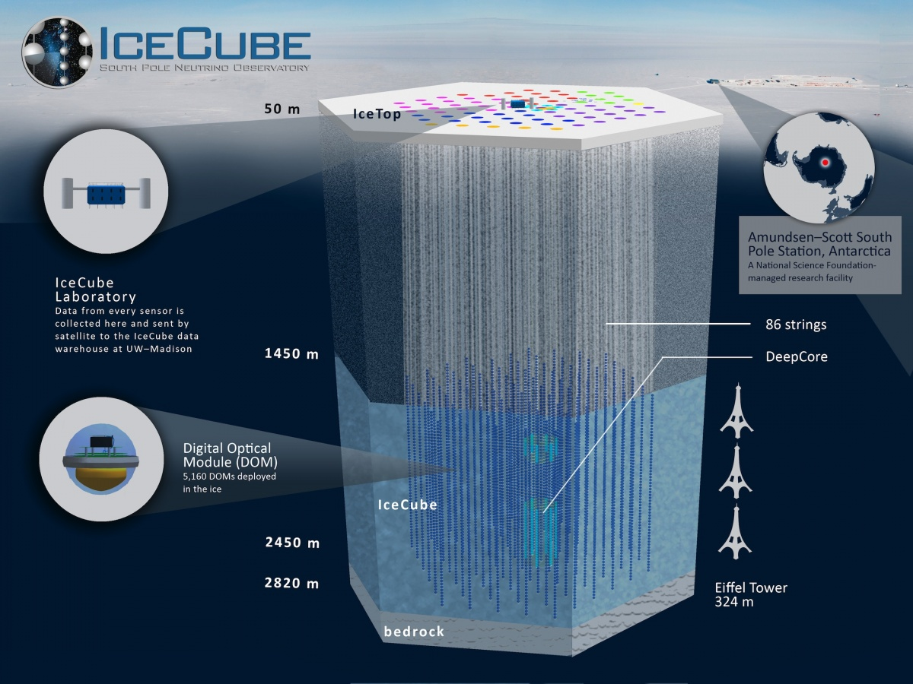
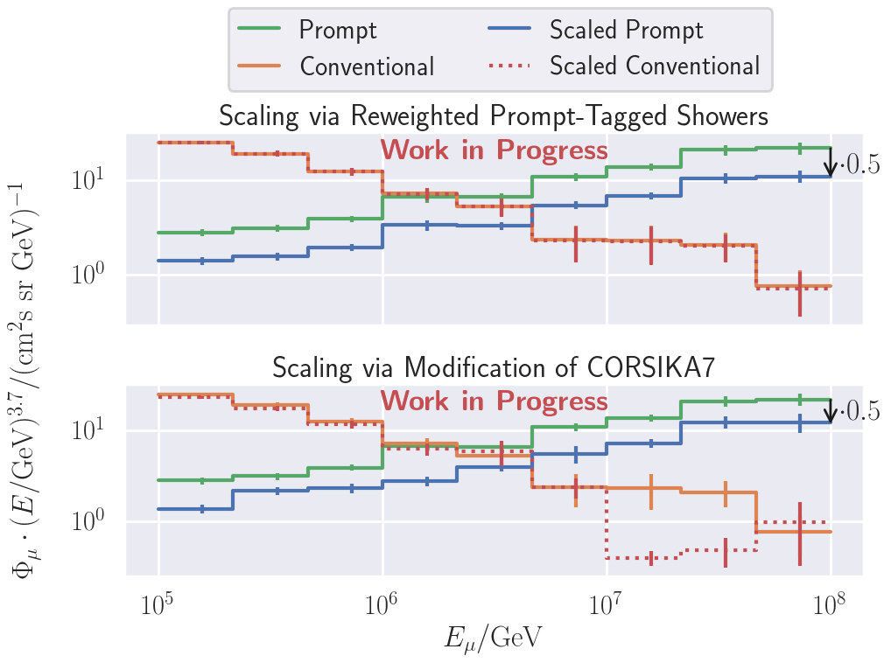
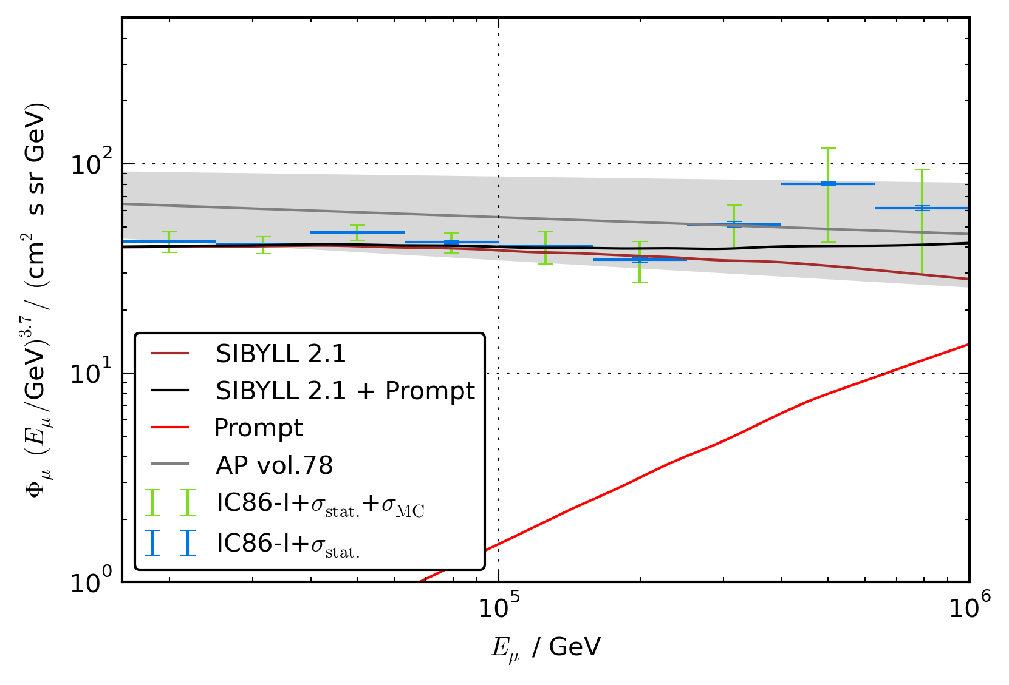
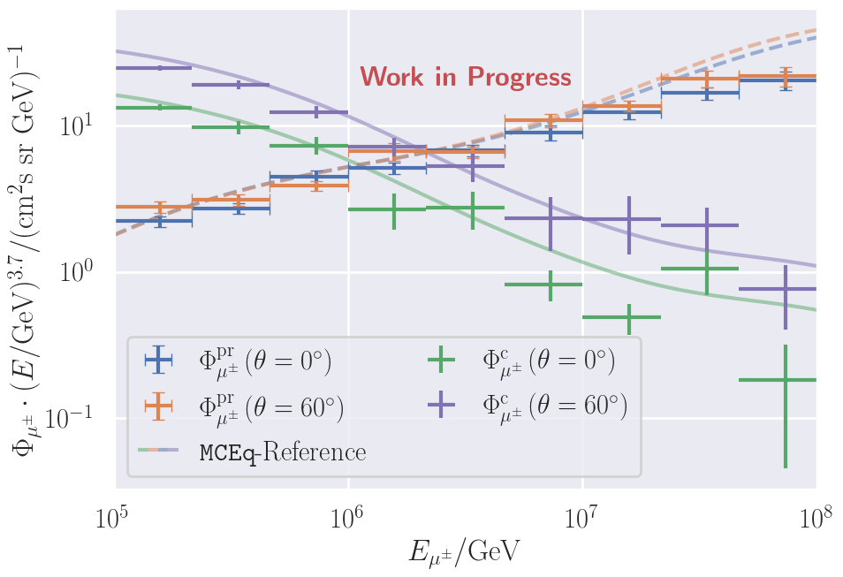
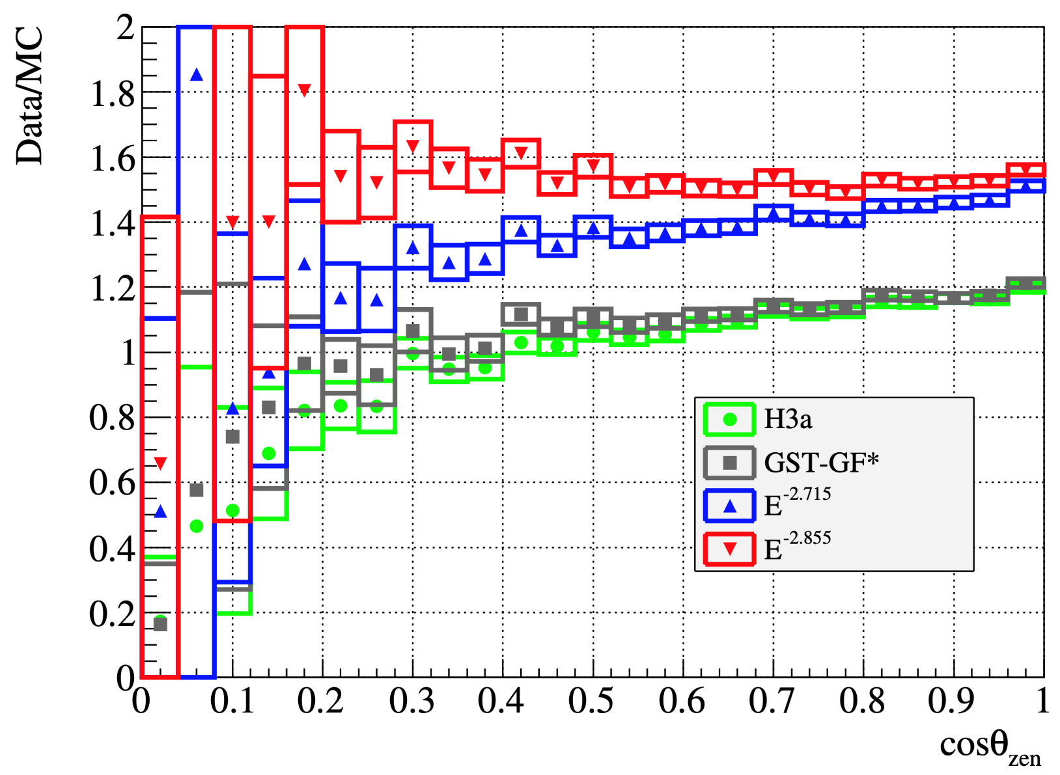
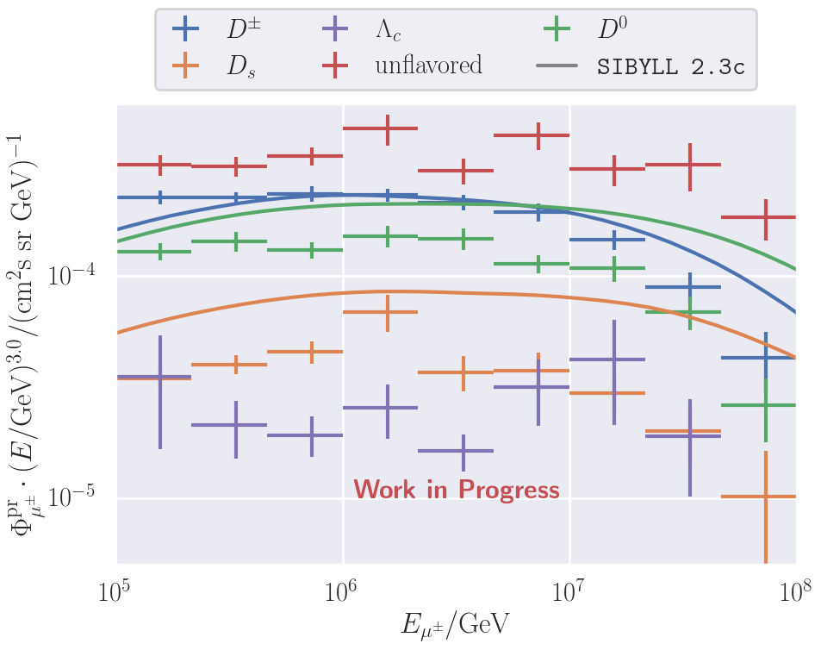
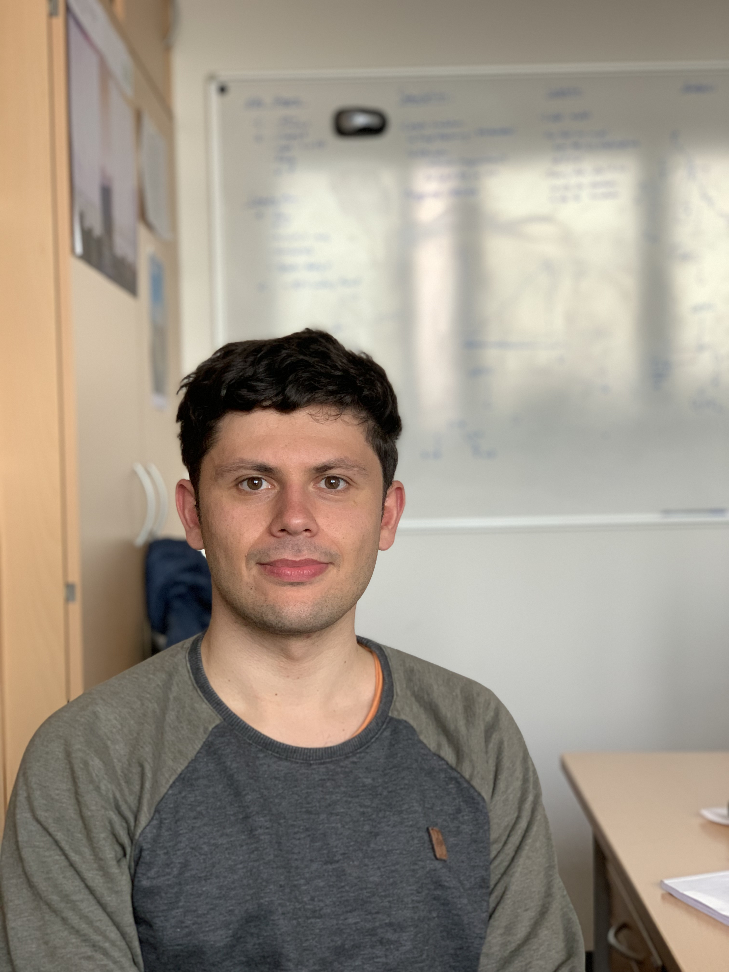
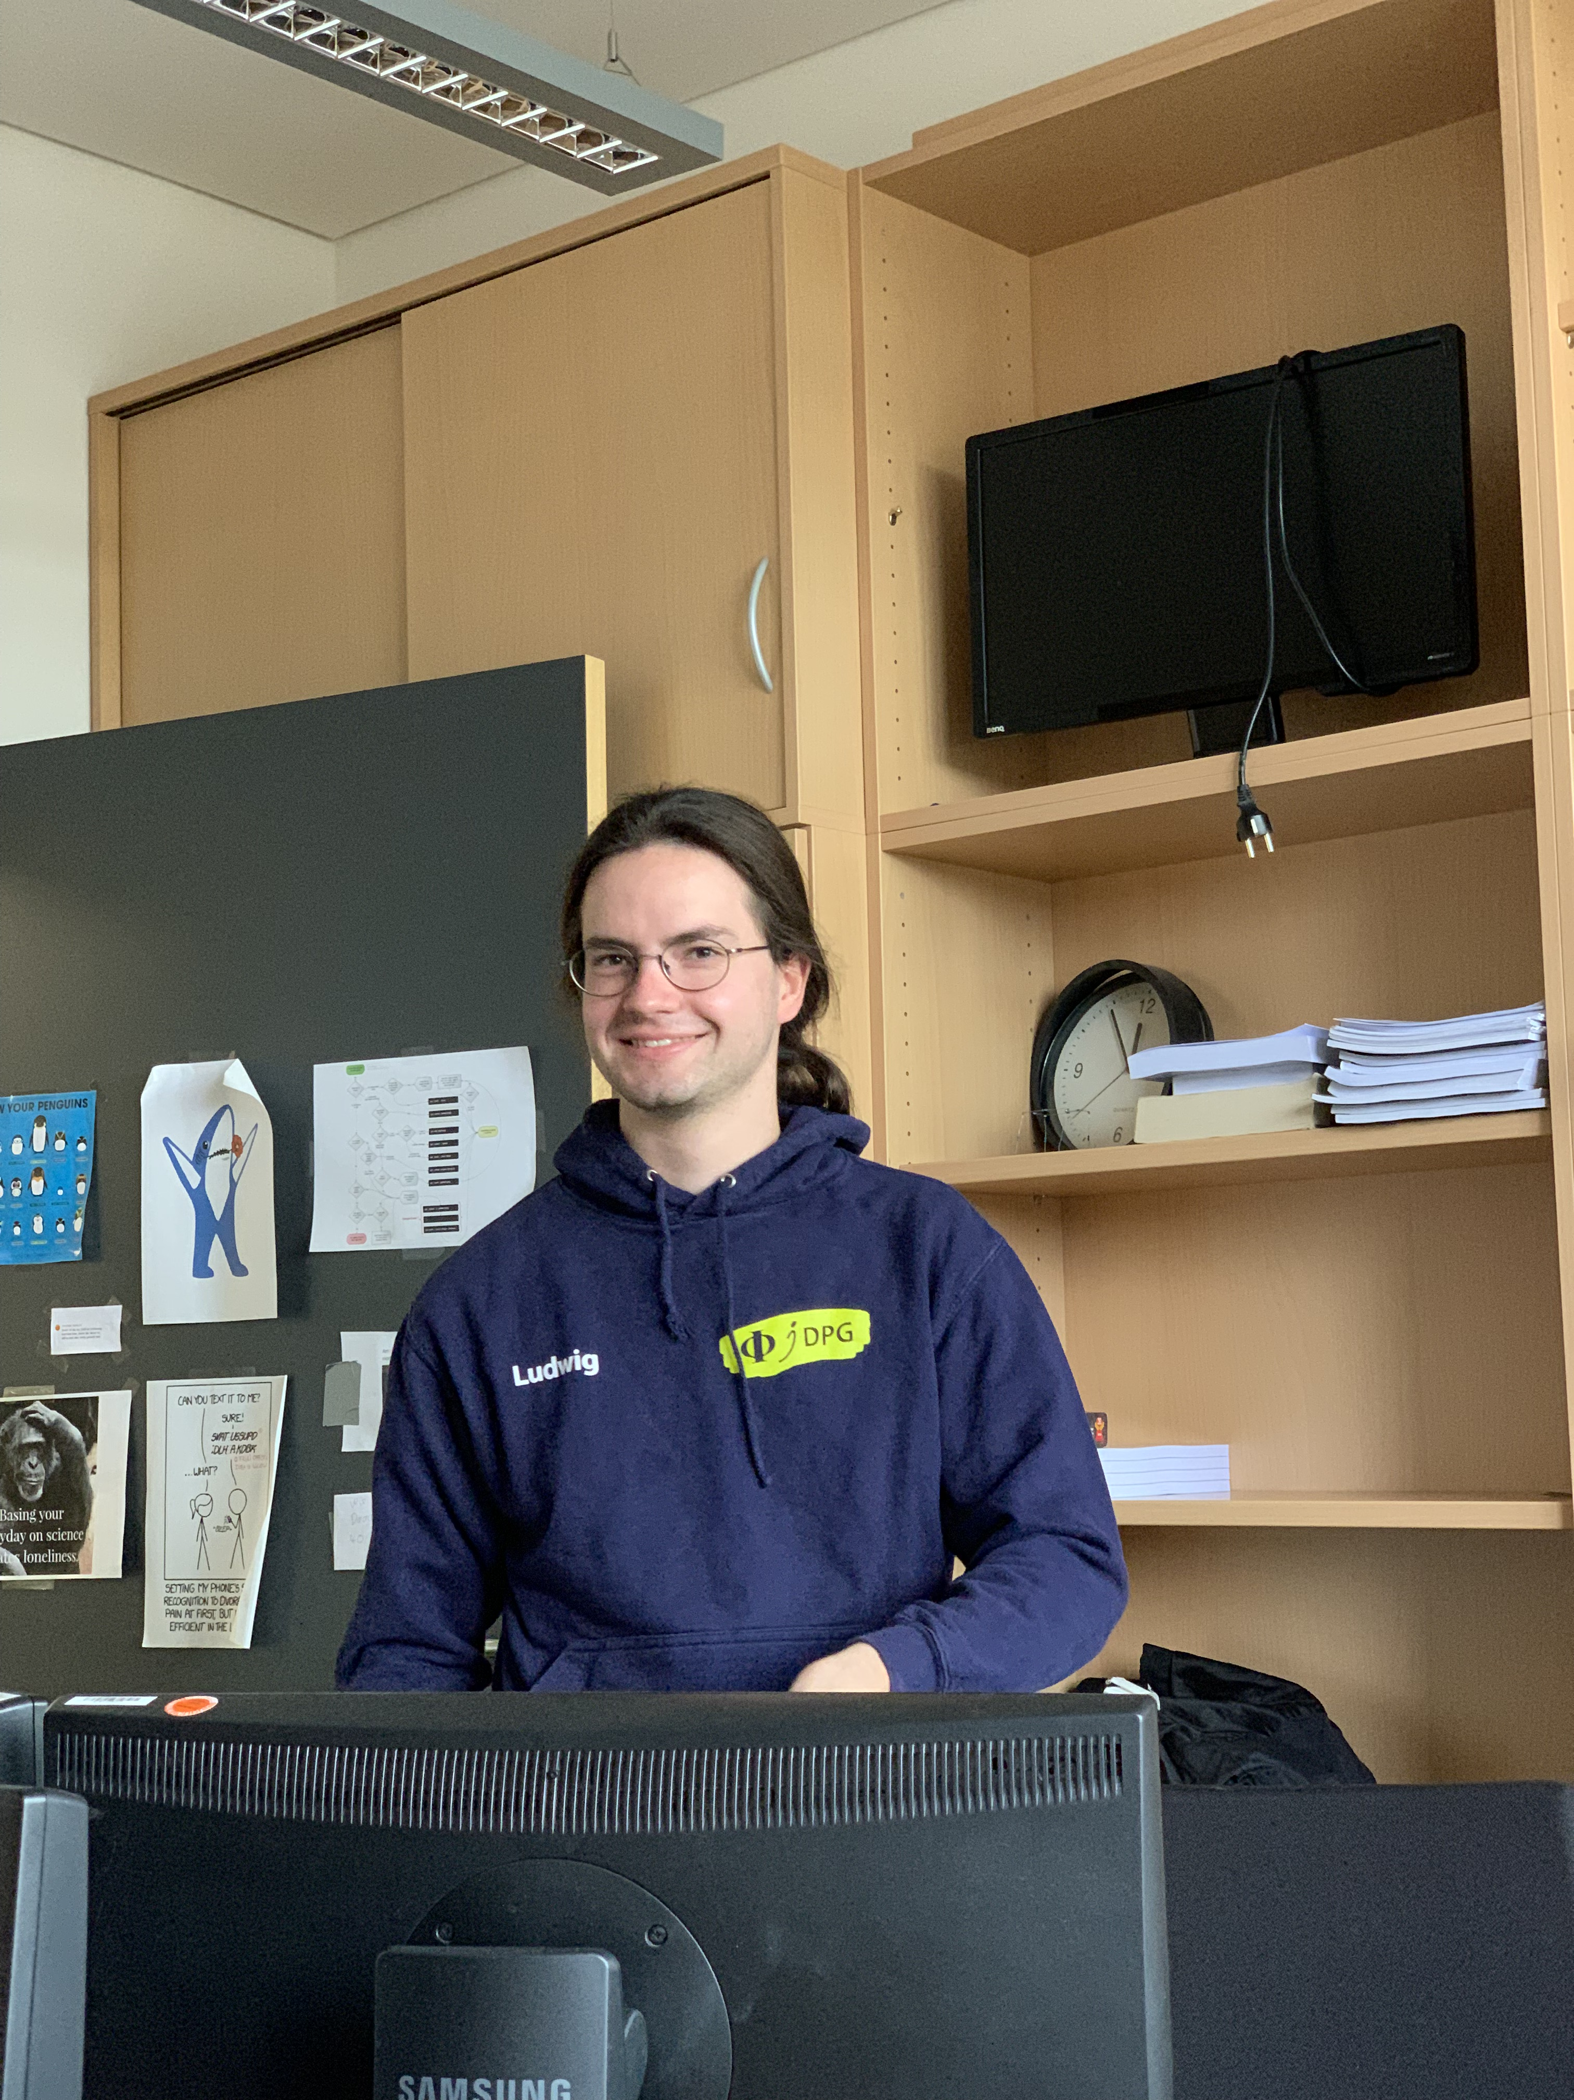



Ideas to measure the prompt component of the atmospheric muon flux
Jean-Marco Alameddine, Ludwig Neste and Pascal Gutjahr
4th Graduate School on Plasma-Astroparticle Physics Bad Honnef 2023
jean-marco.alameddine@tu-dortmund.de, ludwig.neste@tu-dortmund.de, pascal.gutjahr@tu-dortmund.de
Our analysis idea is to compare IceCube data with Monte Carlo simulations, where the simulations can have a varied normalization of the prompt component. This is achieved by creating a single set of shower simulations, but applying a re-weighting to all shower events containting prompt muons, thus creating individual simulation sets with a different prompt normalization. This approach avoids the need to create new air shower simulations (which are computationally expensive to run) for each different prompt normalization The plots above show the muon energies for simulations with different weights.
Sensitive to the normalization of the prompt component is the contribution of high-energy muons, but also zenith-dependent effects as well as seasonal variations.
Cosmic rays interact with our atmosphere and produce large air showers, generating several types of stable and unstable particles. The unstable daughter particles decay and muons can be produced, which are able to reach the earth’s surface. This atmospheric muon flux is divided into a conventional and a prompt
component. Conventional muons come from pions and kaons, which have a long lifetime compared to the other particles that are defined as prompt. Due to the short lifetime of the prompt particles, they decay nearly instantly and lose almost no energy. This means that the prompt muon flux follows the spectrum of the primary cosmic ray flux and starts to dominate at energies higher than TeV.
A significant discovery of the prompt muon flux has not yet been made. However, learning more about the prompt component can help us to better understand the physics of hadronic interactions.
In this analysis, new air shower simulations will
be performed with the latest CORSIKA version, including hadronic interaction models describing
the charm component as well as information about the particle history of muons. We intend to use these simulations to perform a measurement of the prompt muon flux using the IceCube Neutrino observatory.
Analysis idea
Introduction
masterclass.icecube.wisc.edu
$$Φ_{tot}= Φ_{conv}+ Φ_{prompt}$$
Atmospheric Muon Flux
𝝿, 𝞙 ∝ E^{-3.7}
prompt ∝ E^{-2.7}
(all particles with a decay length lower than 0.123 cm)
An analysis to measure the prompt components was done by T. Fuchs in [1]. The energy spectrum of leading muons with
E_{max} / E_{tot} > 0.5 was unfolded and a fit of the normalization was performed for several prompt models. Due to the lack of sufficient Monte Carlo simulations, the factor $N_{prompt}$describing the prompt component in this analysis has been determined to be compatible with zero.
$$Φ\left(E\right)=N_{conv}∗Φ_{conv}(E)+N_{prompt}∗ Φ_{prompt}(E)$$
Another analysis was done in [2]. Hints of the
prompt muon flux are already presented, but an unreasonable mismatch between data and MC occurs in the cosine zenith distribution. A constant offset of about 20 % more data is observed over the entire range on trigger level. After applying quality
cuts, the ratio diverges. In both simulations, the hadronic interaction model SIBYLL 2.1 was used which does not consider charmed particles.
For a first test data set, we use the simulation framework CORSIKA to simulate 10 Mio. air shower for two different injection angles 𝜃. Hadronic
interactions are modelled with SIBYLL 2.3d. Protons are generated as primary particles with energies from 10⁵ GeV to 10⁹ GeV using a powerlaw of E⁻¹ reweighted to Gaisser H3a. To tag the parent particles of the muons, we use the extended history option (EHIST) of CORSIKA. The results are compared to curved produced with MCEq using SIBYLL 2.3c for the prompt and conventional component. The deviations at energies higher than 10⁷ GeV are caused by the maximum simulated energy being lower than the GZK cut off at ~5 * 10⁹ GeV.
Furthermore, we compare the parent particle types of the prompt muons with the MCEq prediction.
We were unable plot all prediction curved due remaining restrictions in MCEq.
Former Analyses
First feasibility studies
To verify the results obtained with the extended history option, we plan to make cross-checks using DYNSTACK, where we try to manually reproduced the results obtained with the extended history option
We are working on an implementation of our CORSIKA simulations into the IceCube simulation chain
We are going to create a significant and physical IceCube Monte Carlo simulation dataset
Finally, an unfolding of the muon flux in energy/zenith bins and a fit of the normalization will be performed
Current status and next Steps
References
[1] T. Fuchs, PhD Thesis, 10.17877/DE290R-17241
[2] Astropart. Phys. 78 (2016) 1-27
Jean-Marco
Ludwig
Pascal
⋆ This work has been supported by the DFG, Collaborative Research Center SFB 876 (project C3) and Collaborative Research Center SFB 1491 (project F3) as well as by the BMBF, project 05A20PEA.
Notes:
Seitenlayout eingestellt auf Din A0: 84,1cm x 118,9cm

